Slide 1

UNIVERSITY INSTITUTE OF ENGINEERING
COMPUTER SCIENCE ENGINEERING
Bachelor of Engineering (Computer Science & Engineering)
Subject Name: Block chain Technology
Subject Code: CSA-467
Prepared By:
Er. Ankita Sharma
DISCOVER . LEARN . EMPOWER

Slide 2
Verification challenges in smart contracts
Verification challenges in smart contracts refer to the difficulties and complexities involved in ensuring the correctness, security, and reliability of the code and logic within smart contracts. Due to the decentralized and immutable nature of blockchain, once a smart contract is deployed, it becomes very difficult to modify or rectify any errors. As a result, thorough verification is crucial to prevent vulnerabilities, bugs, and potential financial losses. Here are some verification challenges associated with smart contracts:

Slide 3
Smart contracts
Smart contract are computer programs stored on the block chain that allows us to convert traditional contracts into digital parallels.
Smart contracts are very logical - following an “if this then” that structure.
This means they behave exactly as programmed and cannot be changed.
They typically are used to automate the execution of an agreement so that all participants can be immediately certain of the outcome, without any intermediary’s involvement or time loss.

Slide 4
Complex Logic: Smart contracts can involve complex business logic and multiple conditions. Ensuring that all possible scenarios are accurately implemented and tested can be challenging, leading to errors and vulnerabilities.
Human Error: Like any software development process, writing code for smart contracts is susceptible to human error. A small mistake in the code can lead to significant consequences, including loss of funds or incorrect execution.
Lack of Formal Specification: In many cases, smart contracts lack formal specifications that clearly outline the expected behavior and interactions. This makes it harder to verify whether the contract behaves as intended.
Inadequate Testing: Thorough testing of smart contracts is essential, but inadequate or incomplete testing can result in undiscovered vulnerabilities. Real-world usage may uncover issues that were not apparent during testing.

Slide 5
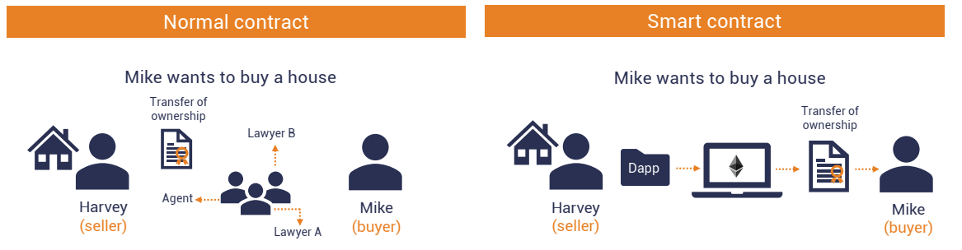

Slide 6
Lack of Standardization: Smart contract development lacks well-established best practices and standards, making it challenging to create consistent and secure contracts across different platforms.
Interactions with External Data: Smart contracts often rely on external data sources (oracles) to make decisions. Verifying the authenticity and accuracy of these external data inputs is crucial to prevent manipulation.
Gas Limit Management: Ethereum and similar platforms use gas limits to prevent infinite loops and resource exhaustion. Developers need to carefully manage gas usage to avoid contract failures.

Slide 7
Upgradeability and Immutability: Balancing the need for upgradability and immutability presents a challenge. Upgrading a smart contract can introduce new vulnerabilities, and ensuring a secure upgrade process is complex.
Security Audits: Conducting thorough security audits by qualified experts is essential, but it can be time-consuming and expensive. Additionally, even a successful audit may not guarantee the absence of all vulnerabilities.
Reverse Engineering and Exploits: Malicious actors may attempt to reverse engineer smart contracts to identify vulnerabilities and exploit them for financial gain.

Slide 8
Predictable outcomes
The human factor is one of the biggest points of failure with traditional contracts.
For example, two individual judges may interpret a traditional contract in different ways. Their interpretations could lead to different decisions getting made and disparate outcomes.
Smart contracts remove the possibility of different interpretations. Instead, smart contracts execute precisely based on the conditions written within the contract's code.
This precision means that given the same circumstances, the smart contract will produce the same result.

Slide 9
Public record
Smart contracts are also useful for audits and tracking.
Since Ethereum smart contracts are on a public block chain, anyone can instantly track asset transfers and other related information.
You can check to see that someone sent money to your address,
Privacy protection
Smart contracts can also protect our privacy.
Since Ethereum is a pseudonymous network (your transactions are tied publicly to a unique cryptographic address, not your identity), you can protect your privacy from observers.

Slide 10
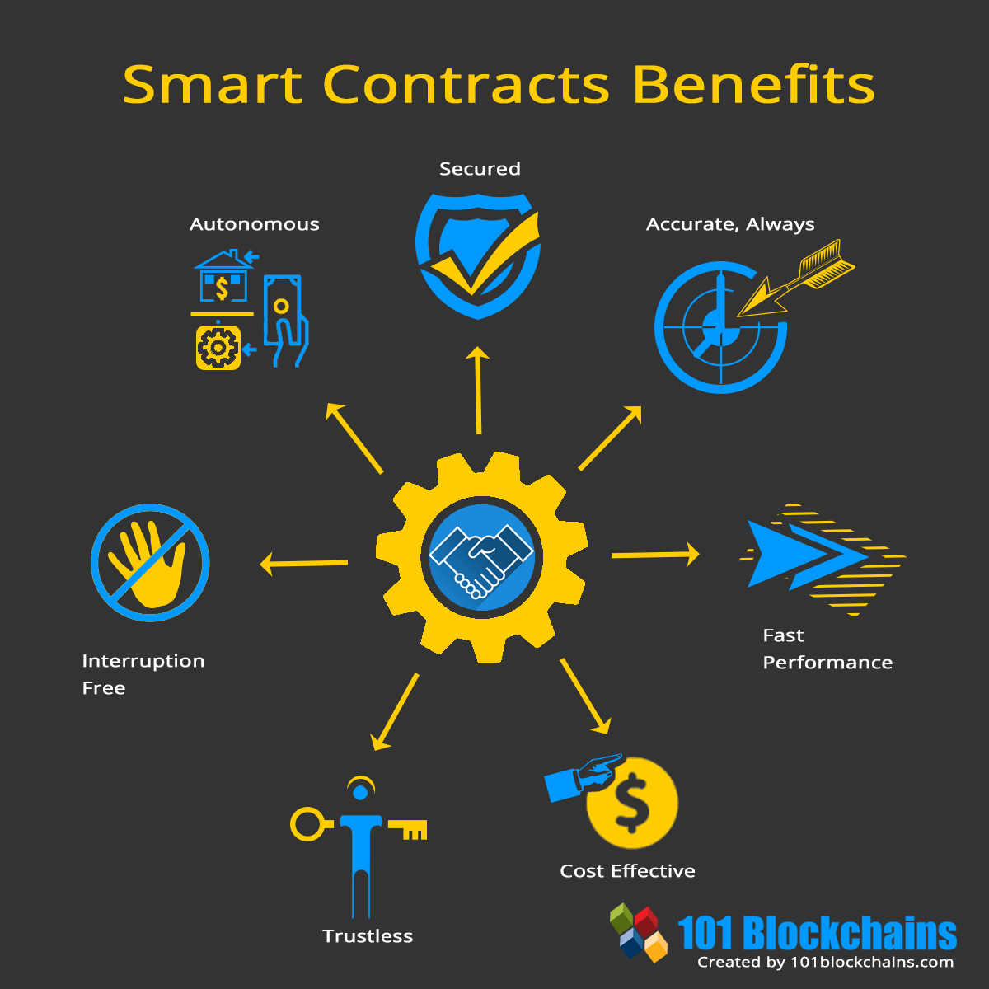
Benefits of smart contracts

Slide 11
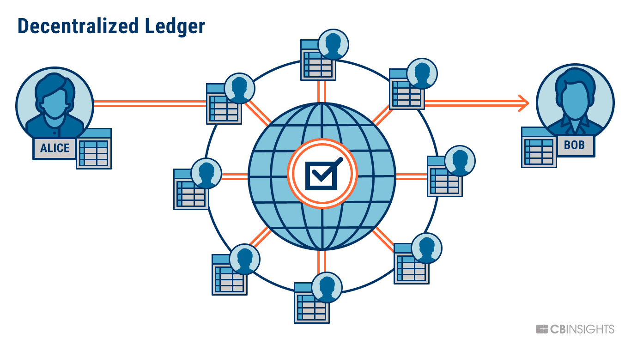
Ethereum block chain
Ethereum is an open-source block chain platform that enables the creation and execution of decentralized applications (dApps) and smart contracts. A block chain is a distributed ledger that records and verifies transactions across a network of computers.
The Ethereum block chain operates on a consensus mechanism called Proof of Stake (PoS), where network participants (known as validators) are chosen to create and validate new blocks based on the amount of Ether they hold and are willing to "stake"

Slide 12
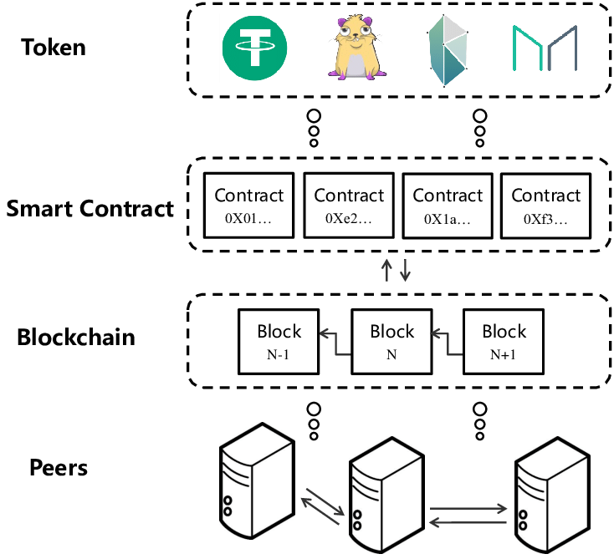

Slide 13
Need for Ethereum
Bitcoin offers only cryptocurrency exchanges.
To build decentralized applications either the traditional bitcoin block chain needs to be upgraded.
Building upon Bitcoin blockchain means living within the intentional constraints of the network and trying to find workarounds.
The limited set of datatypes, transaction types and size of data storage seems to limit the sort of application that could run on Bitcoin.

Slide 14
How does Ethereum work?
Ethereum is powered by the Ethereum Virtual Machine which allows smart contracts to run on a decentralized blockchain. These contracts self-execute only when certain conditions are met.
Smart contracts, like regular paper contracts, establish the terms of an arrangement between parties.
But unlike an old-fashioned contract, smart contracts automatically execute when the terms are met without the need for either participating party to know who is on the other side of the deal — and without the need for any kind of intermediary.
Ethereum Virtual Machine (EVM) is a computation engine which acts like a decentralized computer that has millions of executable projects.
It is considered to be the part of the Ethereum that runs execution and smart contract deployment.

Slide 15
DApp
A decentralized application (DApp, dApp) is an application that can operate autonomously, typically through the use of smart contracts, that runs on a decentralized computing, blockchain system.
Smart contracts are used by developers to maintain data on the block chain and to execute operations. Multiple smart contracts can be developed for a single DApp to handle more complex operations.
Consensus mechanisms are used by DApps to establish consensus on the network. The two most common mechanisms to establish consensus are proof-of-work (POW) and proof-of-stake (POS).

Slide 16
Features
The Ethereum block chain offers several notable features that distinguish it from other block chain platforms. Here are some key features of the Ethereum block chain:
Smart Contracts: Ethereum introduced the concept of smart contracts, which are self-executing contracts with the terms of the agreement directly written into code. Smart contracts enable the automation and execution of agreements, providing transparency, immutability, and eliminating the need for various applications.
Decentralized Applications (dApps): Ethereum serves as a platform for building decentralized applications. Developers can create dApps that leverage the Ethereum block chain's decentralized nature, security, and smart contract functionality. These applications can offer a wide range of functionalities, including decentralized finance (DeFi), gaming, NFT marketplaces, and more.

Slide 17
Tokenization: Ethereum facilitates the creation and management of tokens through its smart contract functionality. Developers can create their own tokens.
Consensus Mechanism: Ethereum is transitioning from the Proof of Work (PoW) consensus mechanism to Proof of Stake (PoS). PoW relies on computational work to validate transactions and create new blocks, while PoS relies on validators who hold and "stake" Ether as collateral. PoS aims to improve scalability, energy efficiency, and network security.
Ethereum Virtual Machine (EVM): The Ethereum Virtual Machine is a runtime environment that executes smart contracts on the Ethereum block chain.

Slide 18
Difference Between Bit coin block chain and ethereum Block chain
Basis | Bit coin | Ethereum
Definition | Bitcoin is a decentralized digital currency that can be transferred on the peer-to-peer bitcoin network. | Ethereum is a decentralized global software platform powered by block chain technology. It is most commonly known for its native cryptocurrency, ether (ETH).
Popularity | Bitcoin is the most popular digital currency in the market to date. | Ether, native currency of Ethereum is the second-largest cryptocurrency after bitcoin to date.
Consensus Mechanism | The Proof-of-Work (PoW) is the consensus mechanism used by the Bitcoin network. | The Proof-of-Stake is the consensus mechanism used by Ethereum.
Block Time | The block time of bitcoin is 10 minutes. | The block time of Ethereum is 14 to 15 seconds.

Slide 19

Ethereum is an open source, distributed software platform based on block chain technology . It has its own native cryptocurrency called Ether and a programming language called Solidity. Blockchain is a distributed ledger technology that keeps a permanent, tamper-proof list of records. Ethereum is Bitcoin's main competitor.
Ethereum enables developers to build decentralized applications. Miners produce Ether tokens that can be used as a currency and to pay for usage fees on the Ethereum network. The platform also supports smart contracts, which are a type of digital contract.

Slide 20
Thankyou

